Slide 1

An Open-Source Collaborative
Framework for Digital Health

Slide 2
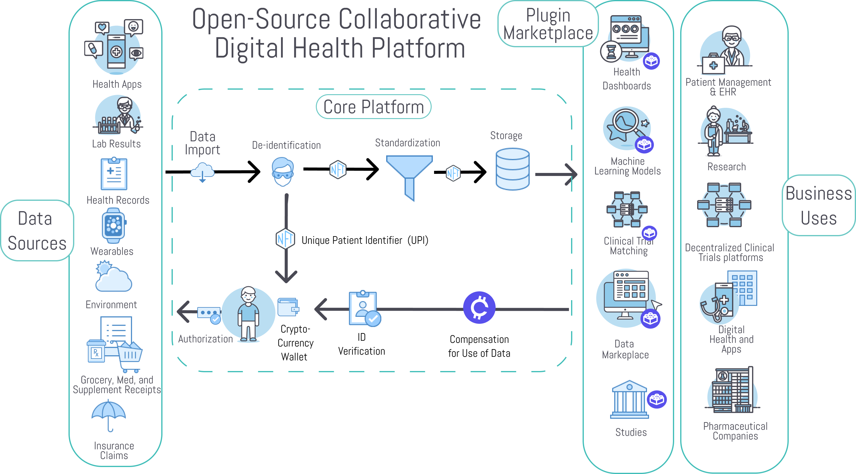

Slide 3
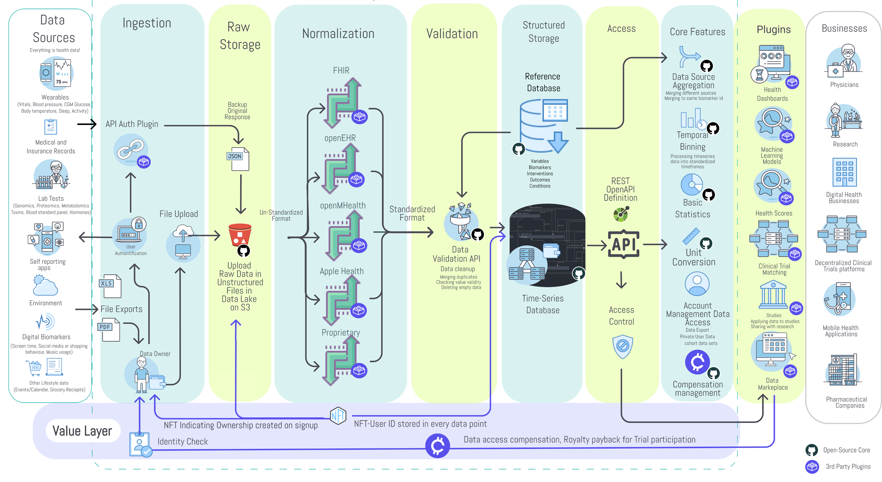

Slide 4
Why is this necessary?
Notes:
So there are already hundreds of thousands of apps and dozens of decentralized research and digital health platforms. So why do we need yet another one?

Slide 5
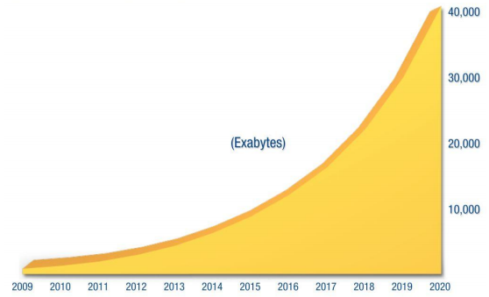

We’ve Seen a 50X Growth in Health Data Over the Past 10 Years
And the creation of 350,000 digital health apps

Slide 6
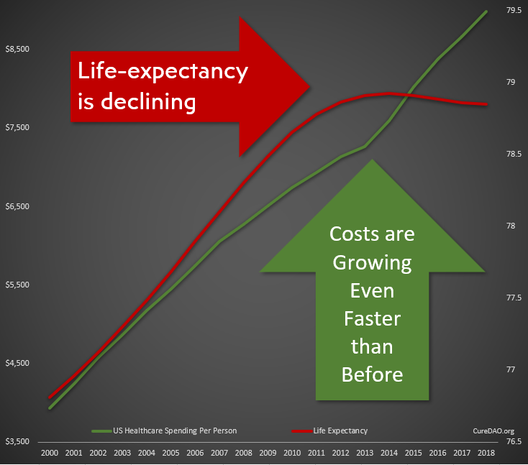
Yet All of This Innovation and Data has Failed to Improve Lifespan or the Cost Burden of Chronic Disease

Slide 7
Problem: Collaboration & Data Sharing
is Punished by the Market
We’re wasting $157 billion paying over 350,000 programmers to write the same code to implement the same basic functionality.
Horizontal Stagnation
Notes:
The free-rider problem and the tragedy of the commons punishes any individual company that open sources it’s code

Slide 8
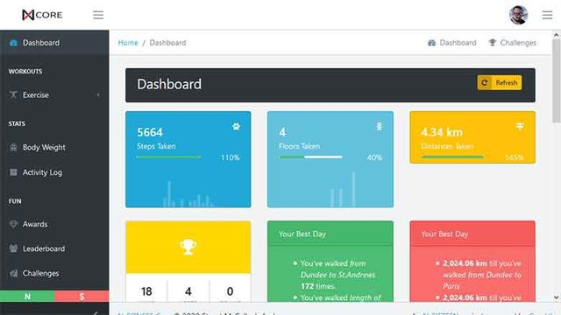
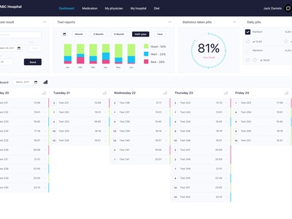
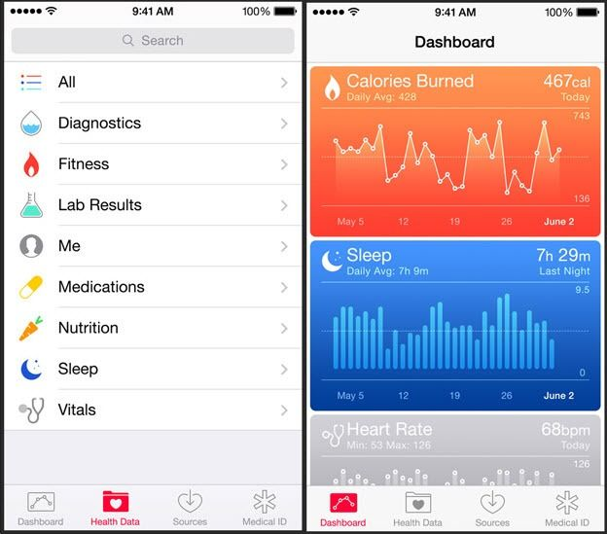
Result: Thousands of Dashboards
Nearly all apps allow you to provide data and show you what you have done rather than what you should do to prevent or treat disease.

Slide 9

Solution: Incentivize Open-Source Collaboration
We can utilize a DAO as a vehicle to reward the creation of public goods.
This allows everyone to stand on everyone’s shoulders, massively accelerating progress.
Vertical Innovation

Slide 10
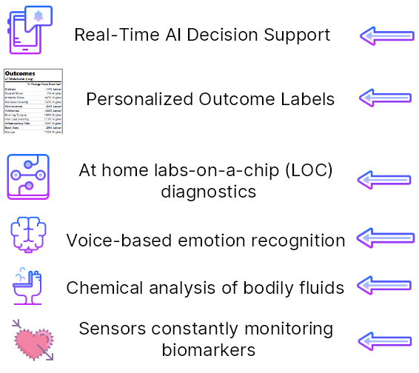
Vertical Innovation
How We Could Be
Spending that
$157 Billion
Notes:
on every medication, food, and nutritional supplement showing the change from baseline for symtoms or disease risk and providing a cost-benefit analysis weighing personal health risk/benfit ratios against the cost of the product.

Slide 11
An Open-Source Ecosystem Model of Success
The WordPress Foundation
Automattic (Wordpress.com)
Maintains the Core WordPress Publishing Platform
GPL Open-Source License
60% Global Market Share
Volunteer contributors make money by selling products and services based on WordPress
For-Profit Company
SaaS Managed WordPress Hosting
$7.5 Billion Valuation
Hosting plans range from freemium to $15,000/month

Slide 12
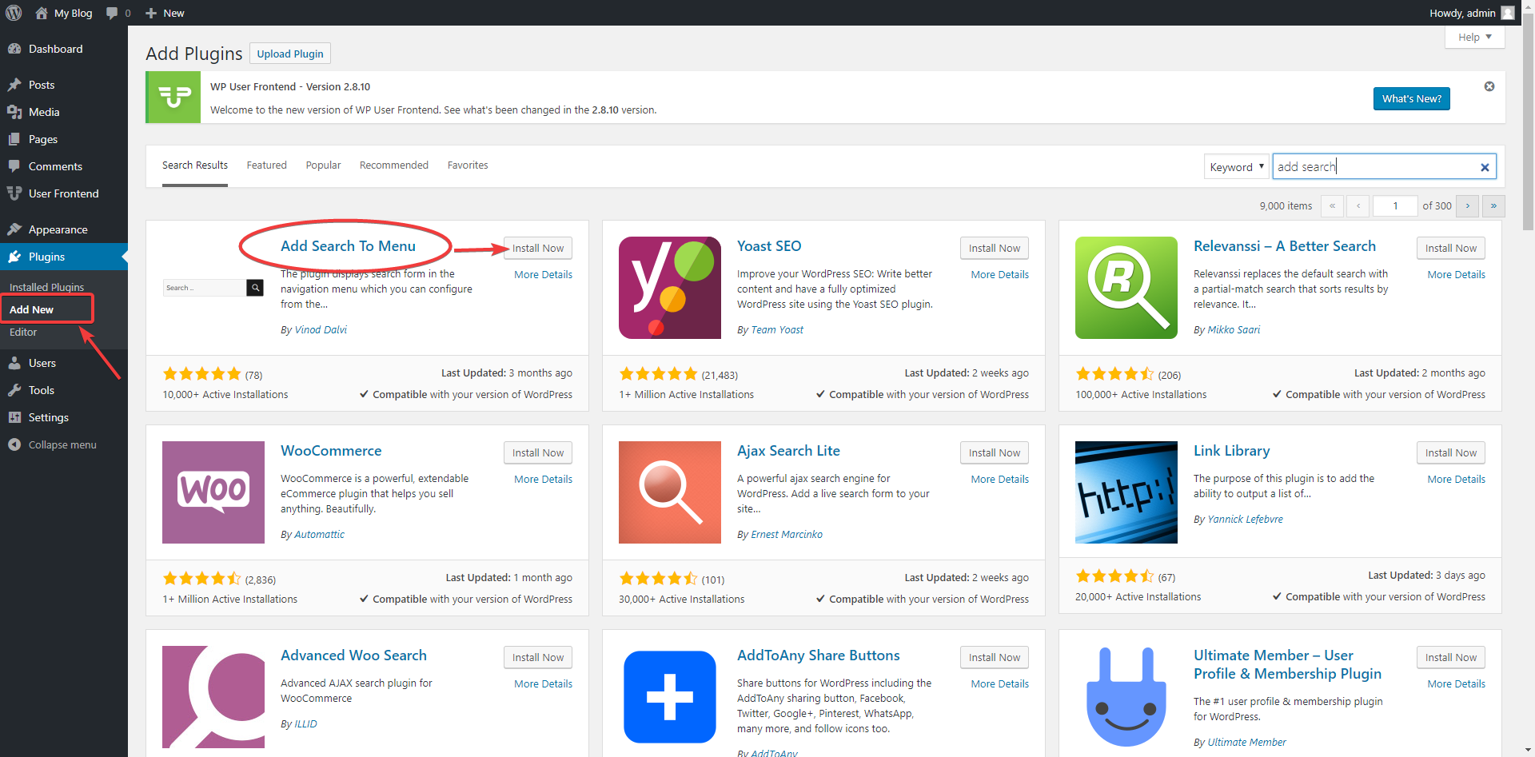
There are more than 59,000 WordPress plugins
The Open-Source Plugin Framework is the Most Critical Factor in its Versatility and Ability to Attract Developers

Slide 13
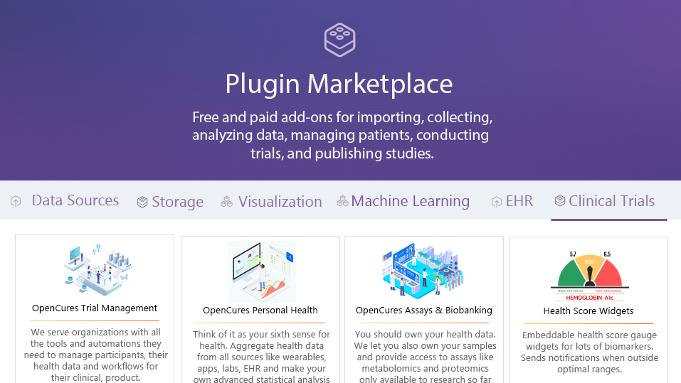

Slide 14
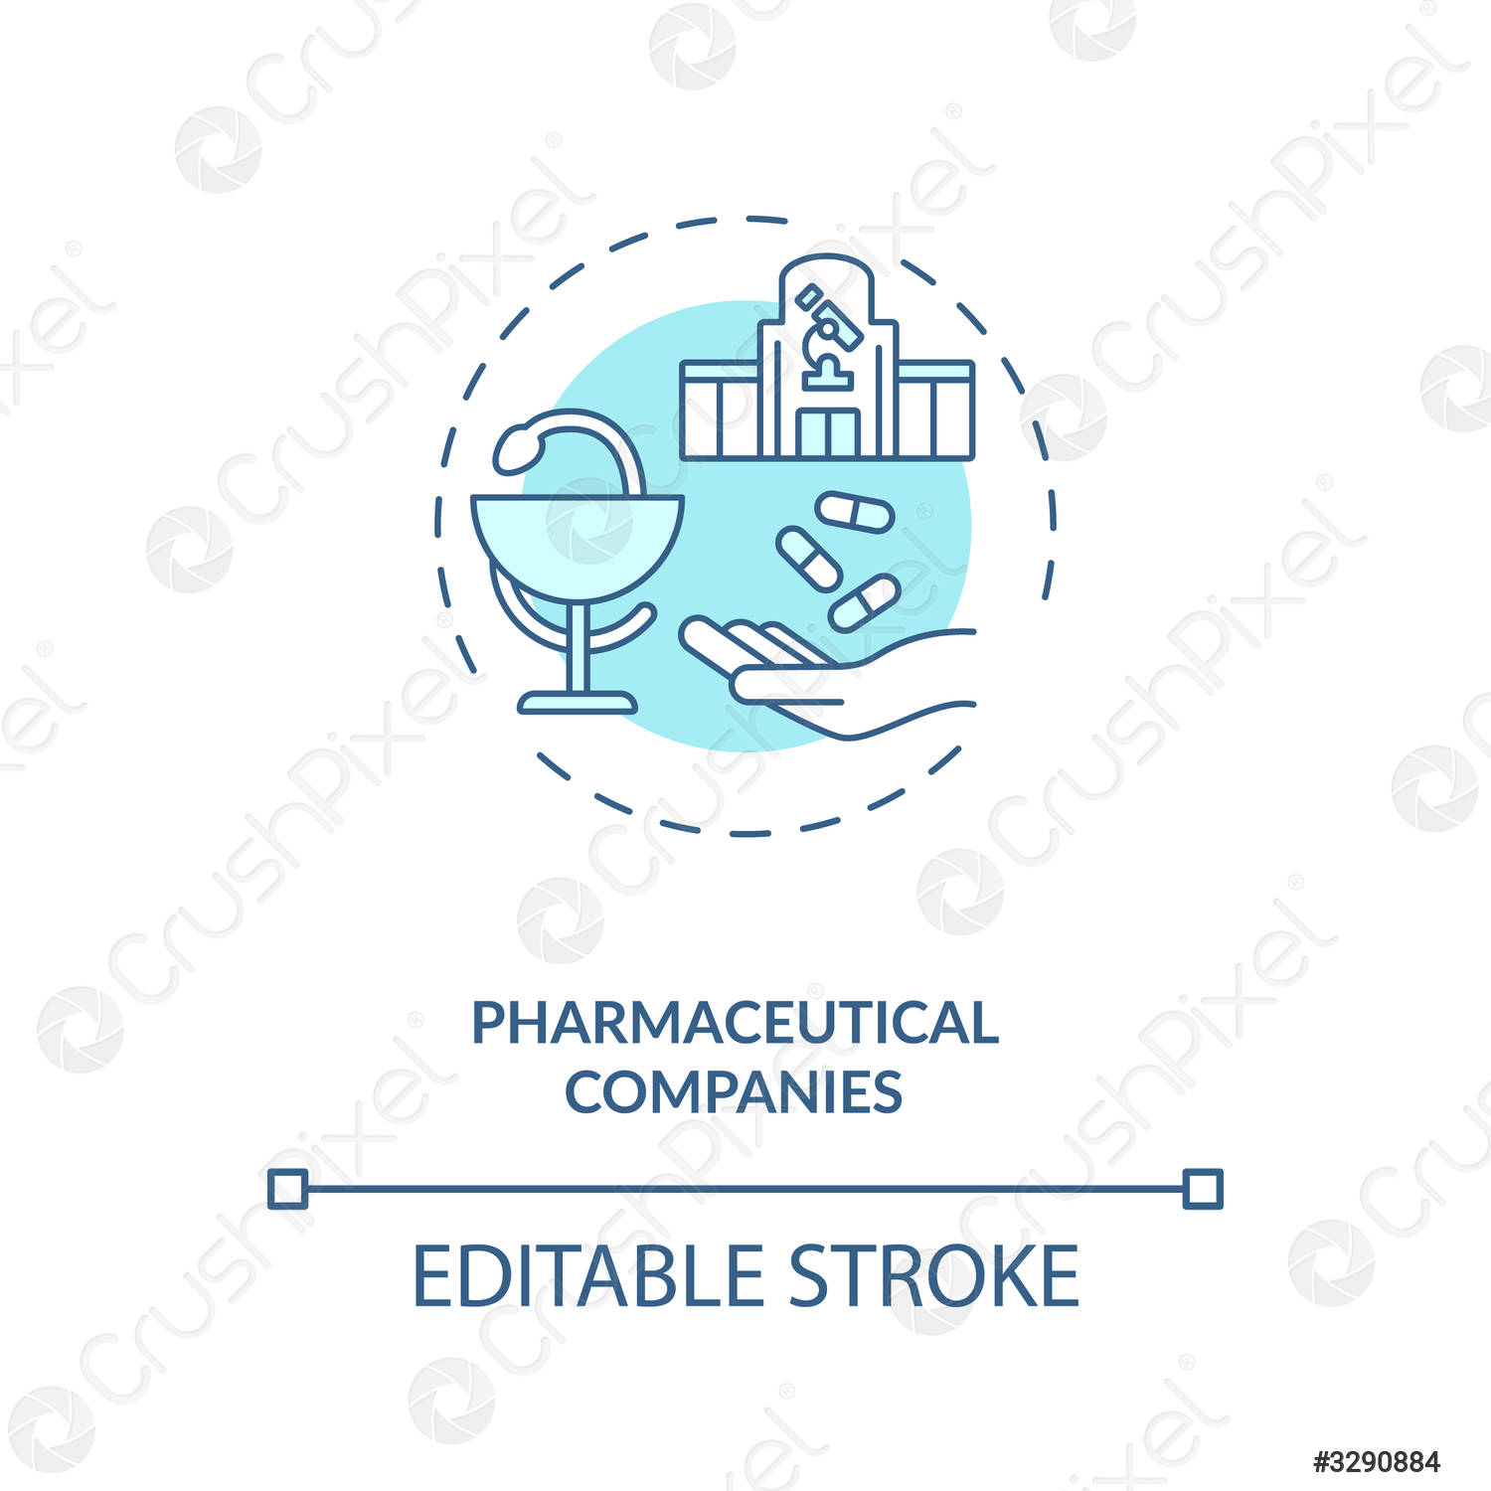
















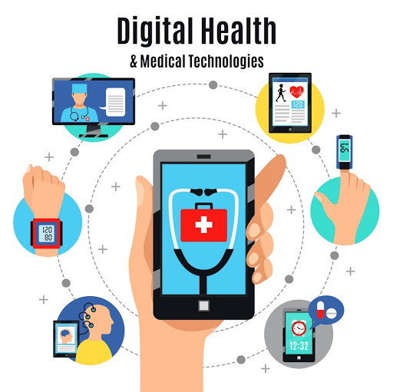


How to Incentivize Collaboration
and Data Sharing
Reduced R&D Costs Through Decentralized Clinical Trial Platform
Grants
Drug Companies
International Regulatory Epidemiological Natural Experiments
Deidentified Data for Drug Discovery
Reduce Exploding Healthcare Costs
De-identified Data Contribution
Personalized Recommendations for Prevention and Treatment of Disease
Reduce Health Agency Development Costs
Individuals
Open-Source Decentralized Clinical Trial Platform
Government
Ongoing NFT Royalties
Reduce Healthcare Expenditure by Facilitating Preventative Discoveries
Supplement Receipt Data
Code, Content and IP Contribution
Grocery Receipt Data
Facilitate De-identified User Data Sharing
Promote Research and Member Engagement More Productive Than Charity Walks
Promotion of Studies
Medication Data
Reduced Development Costs Through Use of White-Label Use of Platform
Software or Data
Ongoing Royalties from NFT
EHR
Developers and Contributors
Insurance Data
Corporate Data Silos
Non-Profits
Digital Health Businesses
Notes:
Should be at 6:00 here
Limit to
Leave numbers out of dictation
Introduce Renato – 1:45
Who Will Pay, 6 segments
Developers
There are 97,000 health apps which can save months of development time and tens of thousands of dollars by using our platform instead of reinventing the wheel.
Researchers
It currently costs $48k per subject in a phase 3 clinical trial. Instead of spending months gathering data, we create a shareable url that researchers can share with participants to authorize access to pre-existing data in quantities never seen before.
Patients
Using our client apps and browser extensions, patients can easily track their symptoms, import data from other sources, and discover hidden dietary, behavioral, and environmental factors that could be exacerbating or improving their symptoms.
Health Insurers
Furthermore, this new digital health solution would help to drive down cost for insurance providers. Health plan providers need a more personalized approach to help their members and have found a way to do so with provider-and patient-reported digital health data. By incorporating this data into a centralized repository, payers can analyze and use this information to create and improve their various member services. For example, in addition to supporting patient-specific care-management models, integrated data could enable the creation of wellness programs, preventive or disease-management care initiatives or even health-coaching programs. This personalized data can go beyond incentivizing and motivating healthy lifestyles; it can also help payers increase member engagement, a critical objective for many health plan providers.
Pharmaceutical Companies
106,000 people die annually in the U.S. from properly prescribed drugs. The number of people having in-hospital, adverse reactions to prescribed drugs to be 2.2 million per year. The total number of deaths caused by conventional medicine is 783,936 per year. Pharmaceutical companies spend over $2 billion a year on over 314,000 events attended by doctors.
Initial sponsor applications will be focused on tracking adverse reactions to the medications known to produce the most adverse reactions. MEDTLC, QuantiModo’s treatment and symptom tracking application would reduce the number of deaths and costs of intervention by alerting patients and their practitioners to conditions before they become irreversible. Additionally, the opportunity to meet and promote these applications to physicians would also serve as a novel new way for pharmaceutical manufacturers to connect with physicians.
Healthcare Providers
A dashboard visualizing all factors in a patient’s health can then help doctors formulate an informed care plan.

Slide 16
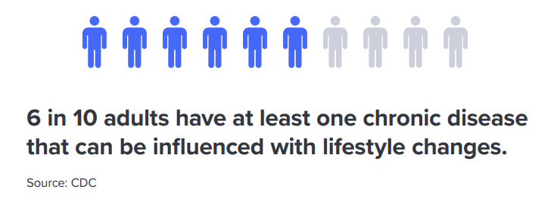

Slide 17

An Open-Source Ecosystem Model of Success
WordPress.org
The WordPress Foundation
(Automattic, LLC)
Maintains the Core WordPress Publishing Platform
GPL Open-Source License
60% Market Share
Volunteer contributors make money by selling products and services based on WordPress
Non-profit
SaaS Managed WordPress Hosting
VIP hosting plan starts at $15,000 per month

Slide 18



CLOSED-SOURCE ALTERNATIVES
Company | Price per user per year | Data Aggregation | Open-Source | Plugin Marketplace | Research Platform
 | $5 | ✓ | ✗ | ✗ | ✗
 | $4 | ✓ | ✗ | ✗ | ✗
CureDAO.com | $3 | ✓ | ✓ | ✓ | ✓
Notes:
Our primary competitors are Validic and the Human API which primarily focus on the aggregation of data from digital health devices. However, they do not provide prebuilt apps, analytics or an end to end solution for researchers.
That market has clearly been validated by recent $12 and $6 million dollar investments in Validic and the Human API this year as well as continued 50% compound annual growthin the the digital health space.

Slide 19
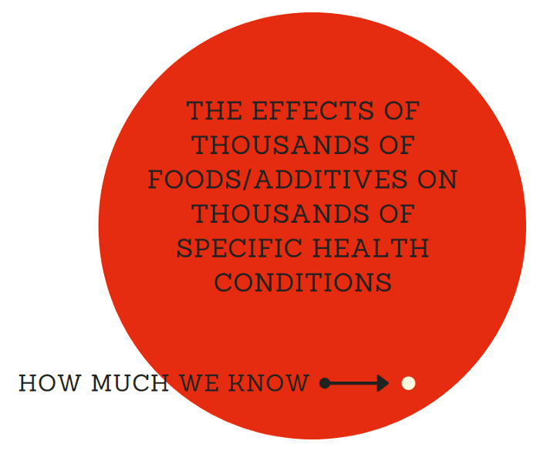

Slide 20
Value Flow Chain
How Stakeholder Will Gets More
Than They Contribute to the Platform
Reduced R&D Costs Through Decentralized Clinical Trial Platform
Grants
Drug Companies
International Regulatory Epidemiological Natural Experiments
Deidentified Data for Drug Discovery
Reduce Exploding Healthcare Costs
De-identified Data Contribution
Personalized Recommendations for Prevention and Treatment of Disease
Reduce Health Agency Development Costs
Individuals
Open-Source Decentralized Clinical Trial Platform
Government
Ongoing NFT Royalties
Reduce Healthcare Expenditure by Facilitating Preventative Discoveries
Supplement Receipt Data
Code, Content and IP Contribution
Facilitate De-identified User Data Sharing
Grocery Receipt Data
Promote Research and Member Engagement More Productive Than Charity Walks
Promotion of Studies
Reduced Development Costs Through Use of White-Label Use of Platform
Software or Data
Medication Data
Ongoing Royalties from NFT
Developers and Contributors
Insurance Data
Corporate Data Silos
Non-Profits
Digital Health Businesses
Notes:
Should be at 6:00 here
Limit to
Leave numbers out of dictation
Introduce Renato – 1:45
Who Will Pay, 6 segments
Developers
There are 97,000 health apps which can save months of development time and tens of thousands of dollars by using our platform instead of reinventing the wheel.
Researchers
It currently costs $48k per subject in a phase 3 clinical trial. Instead of spending months gathering data, we create a shareable url that researchers can share with participants to authorize access to pre-existing data in quantities never seen before.
Patients
Using our client apps and browser extensions, patients can easily track their symptoms, import data from other sources, and discover hidden dietary, behavioral, and environmental factors that could be exacerbating or improving their symptoms.
Health Insurers
Furthermore, this new digital health solution would help to drive down cost for insurance providers. Health plan providers need a more personalized approach to help their members and have found a way to do so with provider-and patient-reported digital health data. By incorporating this data into a centralized repository, payers can analyze and use this information to create and improve their various member services. For example, in addition to supporting patient-specific care-management models, integrated data could enable the creation of wellness programs, preventive or disease-management care initiatives or even health-coaching programs. This personalized data can go beyond incentivizing and motivating healthy lifestyles; it can also help payers increase member engagement, a critical objective for many health plan providers.
Pharmaceutical Companies
106,000 people die annually in the U.S. from properly prescribed drugs. The number of people having in-hospital, adverse reactions to prescribed drugs to be 2.2 million per year. The total number of deaths caused by conventional medicine is 783,936 per year. Pharmaceutical companies spend over $2 billion a year on over 314,000 events attended by doctors.
Initial sponsor applications will be focused on tracking adverse reactions to the medications known to produce the most adverse reactions. MEDTLC, QuantiModo’s treatment and symptom tracking application would reduce the number of deaths and costs of intervention by alerting patients and their practitioners to conditions before they become irreversible. Additionally, the opportunity to meet and promote these applications to physicians would also serve as a novel new way for pharmaceutical manufacturers to connect with physicians.
Healthcare Providers
A dashboard visualizing all factors in a patient’s health can then help doctors formulate an informed care plan.

Slide 21

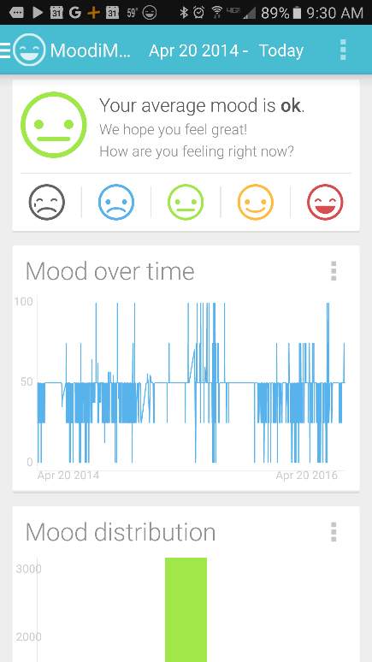
Track Symptoms
Track symptoms in a fraction of a second.
Notes:
First we developed mobile apps and browser extensions to make it incredibly easy to track your symptom severity in a fraction of a second using a unique popup interface.
Move circle
Remove browser
Screenshot of mood tracking screen

Slide 22
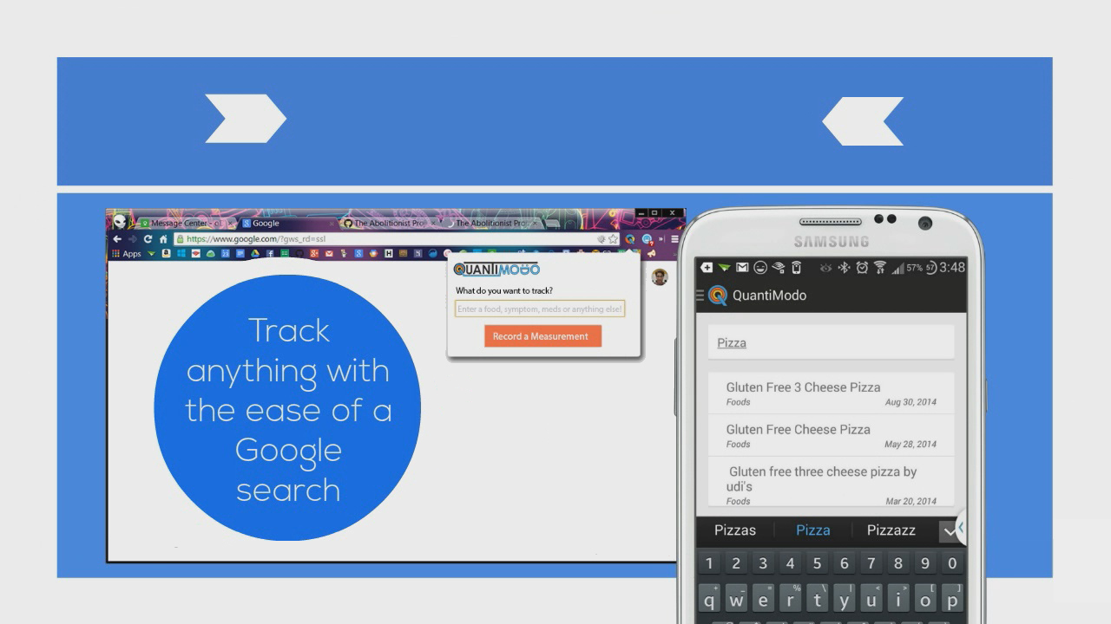
Track Factors
Notes:
Additionally, we make it really easy to track diet, treatments, and anything else that could possibly influence your condition.
Remove Browser image
“Track factors” in

Slide 23
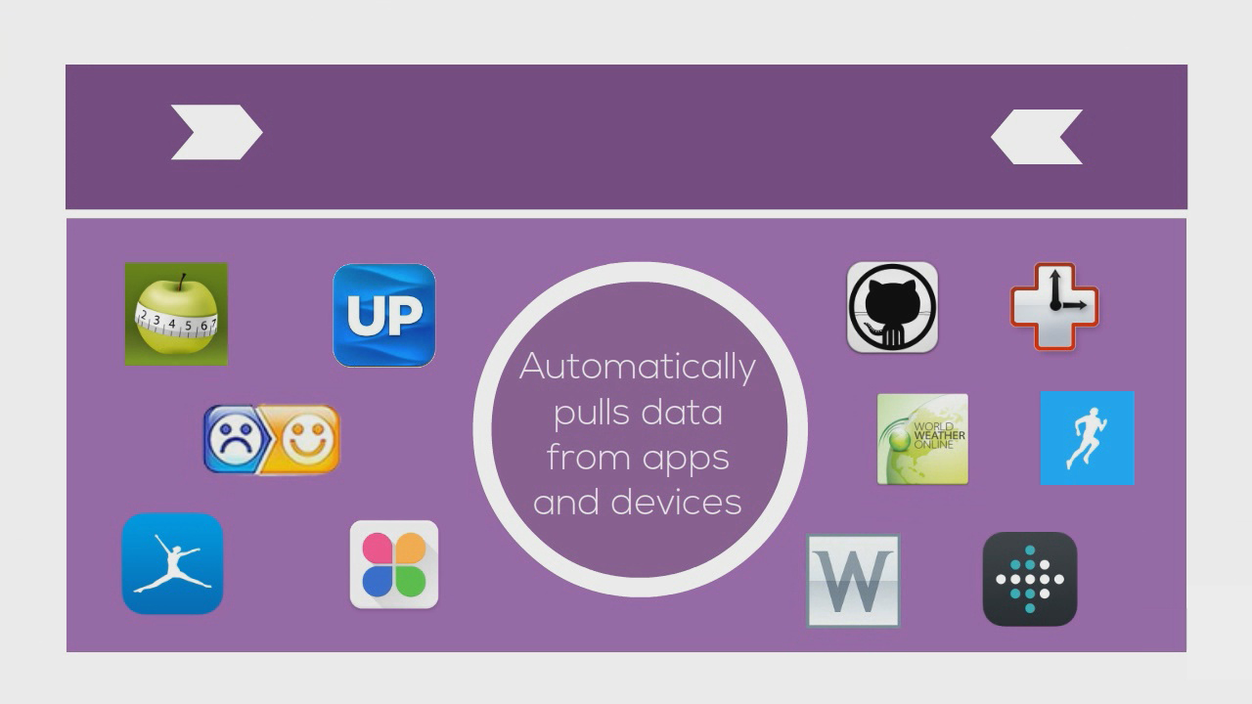

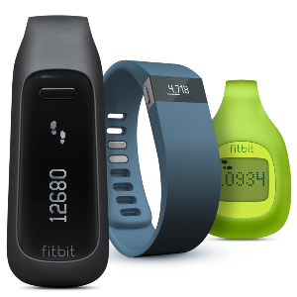


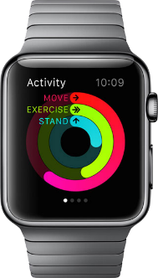
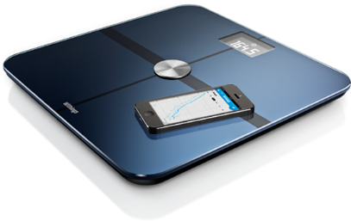
Import Data
Notes:
Move information to left and images on the right.
We also built the QuantiModo Connector Framework, which enabled us to automatically pull passively or actively generated user data from dozens of applications and devices such as Fitbits, Withings scales and blood pressure monitors, and diet data from apps like MyFitnes
The QuantiModo Connector Framework pulls data from dozens of applications and devices such as Fitbits, Withings scales and blood pressure monitors, and diet data from apps like MyFitnessPal.
(Only show most popular ones with names and x more)

Slide 24
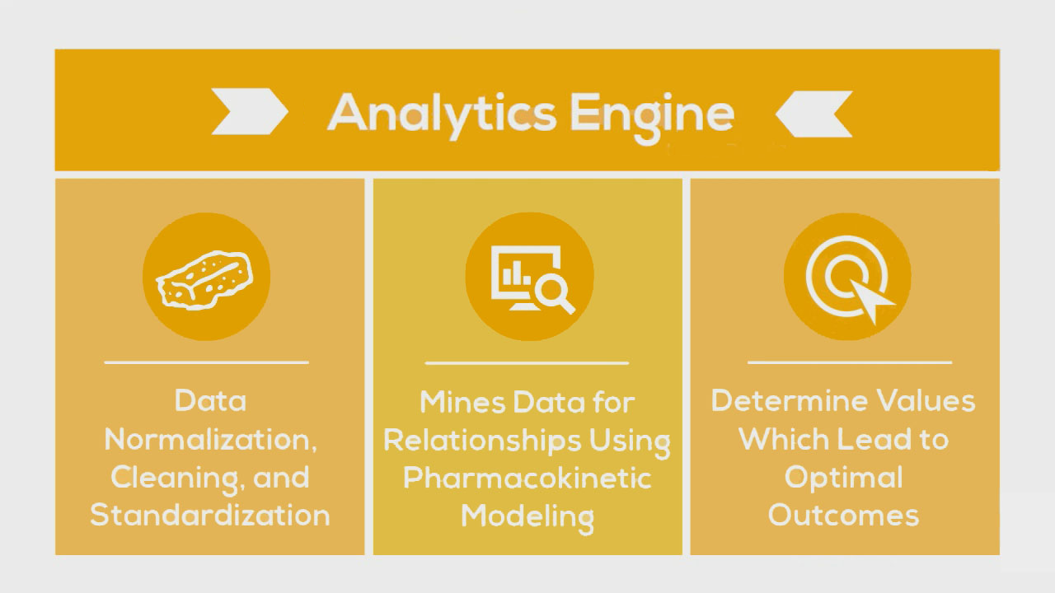
Notes:
Change yellow background
Slow down here
Once we’ve accumulated all of this data, the QuantiModo Analytics Engine then clean the data and mines it using pharmacokinetic modeling techniques, which take into account onset delays and durations of action to determine which factors have the strongest influence on a given outcome and what the optimal daily values are.
e.g. Pizza -> might not notice effects until later that day or even gluten sensitivity until a few days later

Slide 25
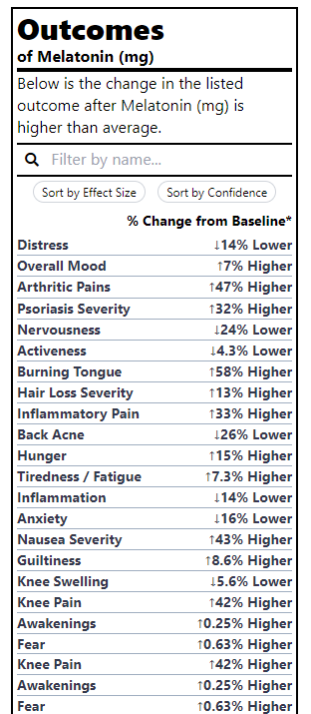
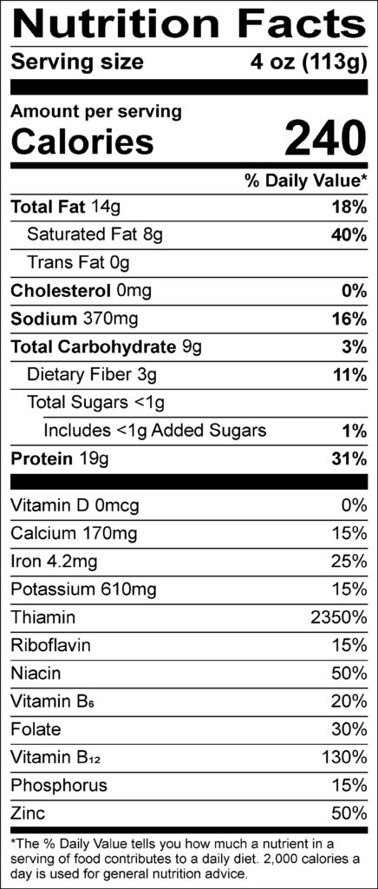
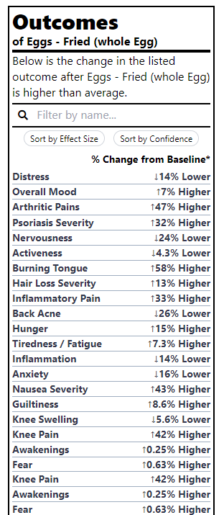

It would be
far more
Valuable to
know the
Health Effects
of Different
Foods than
the Amount
Of Riboflavin
Notes:
Name all 4 quickly
And finally, this enables the user to select any symptom or outcome of interest and then see which factors are most predictive of that outcome. Here we see the top factors most predictive of reduced inflammatory pain. The strongest predictor is Omega 3 Fatty acids that this says that my inflammatory pain is typically 27% lower after I take 400mg of inflammatory pain.

Slide 26
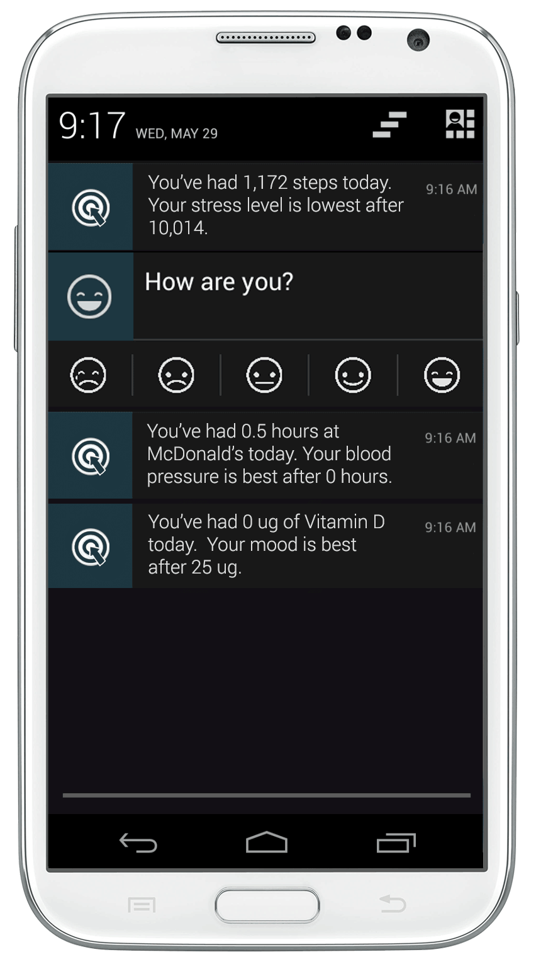

Slide 27

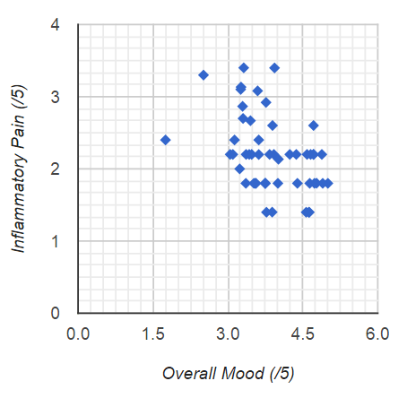
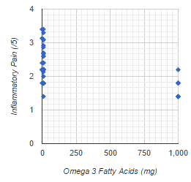
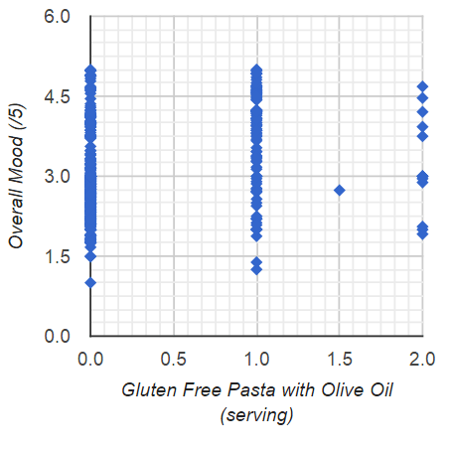
DISCOVERIES
Anti-Inflammatory
Pro-Inflammatory
Shared Cause
Notes:
[Bold text or change yellow background]
The first discovery I made was that the severity of my symptoms correlated very highly with each other, indicating a common underlying root cause. And another discovery was that increased severity was most strongly correlated with prior gluten and sugar intake. So all of these separate conditions were actually just symptoms of the same underlying root cause. That root cause being an inflammatory immune reaction caused by dietary factors. So I removed those from my diet and within a couple weeks or so nearly all the symptoms that I had been dealing with for years went into near complete remission.
When I first started doing this, all this tracking, data aggregation and analysis was extremely arduous, so a few years ago, I started working on a platform called QuantiModo to make it as easy enough for anyone else to use this empirical approach to managing their condition.

Slide 28
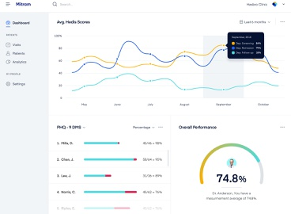
Problem 1: Horizontal Stagnation
We’re spending $157 billion paying over 350,000 programmers to implement the same core fundamental functionality.
Result: Thousands of Dashboards
Nearly all show you what you have done rather than what you should do to prevent or treat disease.

Slide 29

Step 2. Researchers Make Discoveries
Step 1. Participants Share Data
Step 3. Actionable Insights
Notes:
A half billion are suffering [pause here] from autoimmune diseases like Crone's disease, psoriasis, and Fibromyalgia.
Another half a billion people are suffering from depression and other mental illnesses.
Indeed 12 people will have committed suicide by the end of this presentation. Hopefully, not as a result of this presentation, but I believe due to massive failures in our current systems of clinical research and diagnosis. Currently, it costs as much as $48,000 per subject in a Phase III clinical trial. This has resulted in very little data on the effects of any factors that aren’t patentable. Furthermore, something that all of these diseases have in common…

Slide 30


3. New Ways to Prevent and Alleviate Disease
2. Researchers Make Discoveries
1. Participants Share Data
Supplements
Global Anonymous Health Data Bank
Groceries
Open-Source Analysis Software
Medications
Physicians
Developers
Insurance
Patients
Researchers
Notes:
A half billion are suffering [pause here] from autoimmune diseases like Crone's disease, psoriasis, and Fibromyalgia.
Another half a billion people are suffering from depression and other mental illnesses.
Indeed 12 people will have committed suicide by the end of this presentation. Hopefully, not as a result of this presentation, but I believe due to massive failures in our current systems of clinical research and diagnosis. Currently, it costs as much as $48,000 per subject in a Phase III clinical trial. This has resulted in very little data on the effects of any factors that aren’t patentable. Furthermore, something that all of these diseases have in common…

Slide 31
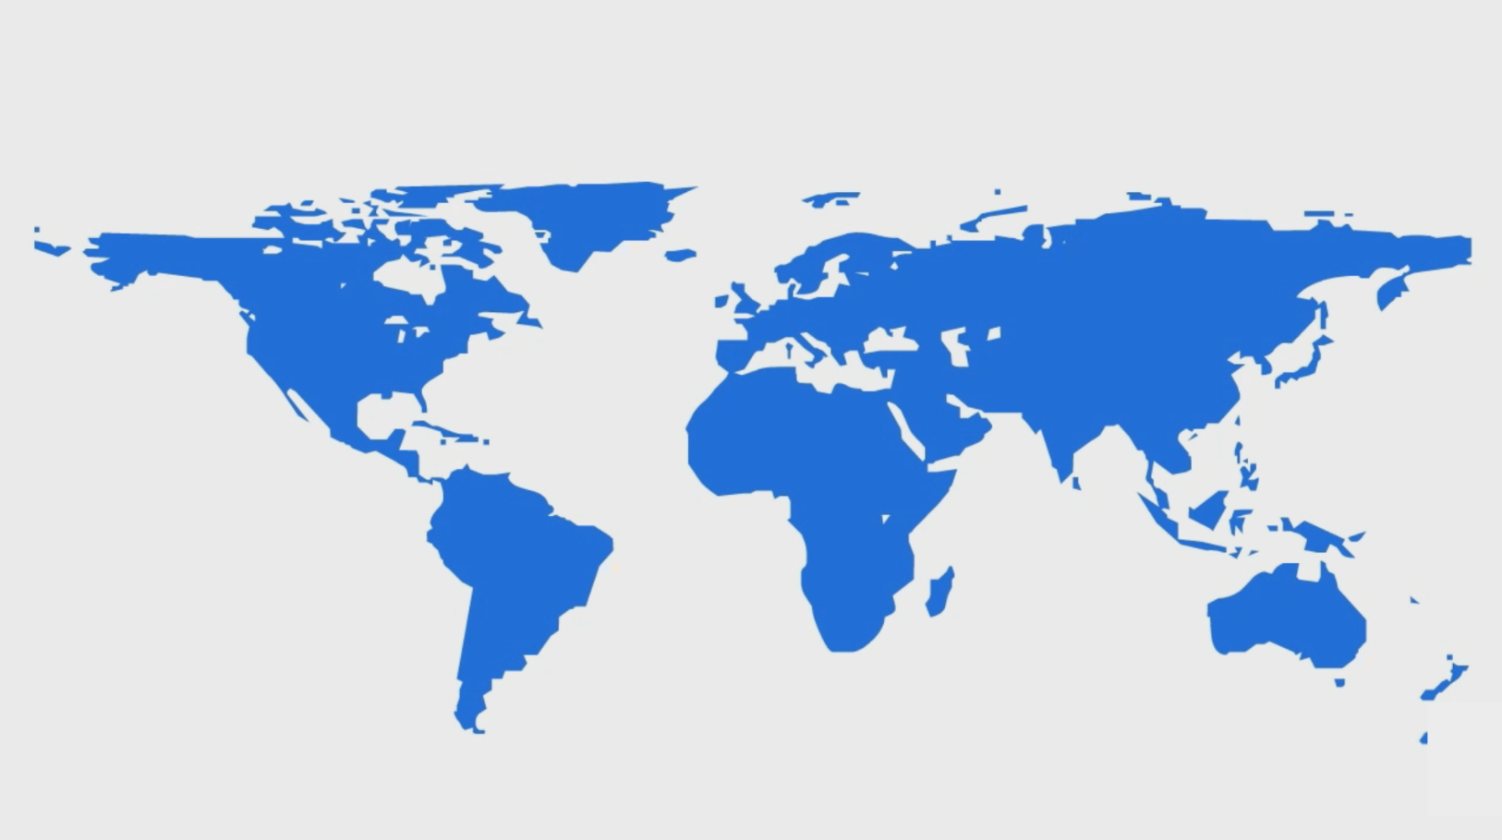
CHRONIC DISEASES
Mental Illness
479 million sufferers
Dementia
50 million sufferers
Notes:
A half billion are suffering [pause here] from autoimmune diseases like Crone's disease, psoriasis, and Fibromyalgia.
Another half a billion people are suffering from depression and other mental illnesses.
Indeed 12 people will have committed suicide by the end of this presentation. Hopefully, not as a result of this presentation, but I believe due to massive failures in our current systems of clinical research and diagnosis. Currently, it costs as much as $48,000 per subject in a Phase III clinical trial. This has resulted in very little data on the effects of any factors that aren’t patentable. Furthermore, something that all of these diseases have in common…

Slide 32
Why Alzheimer’s disease is bad
Some people live up to 20 years with the disease
Loss of ability to communicate could be like decades of solitary confinement
Potential decades of constant pain due to any co-occurring disease of aging cannot be communicated and treated
Potential for decades of constant sheer terror, rage and confusion
Unable to follow sitcoms long enough to get jokes
Potential time dilation could make years of this hellish existence feel like an eternity
You wouldn’t even have the cognitive capability to escape this living hell through suicide
Notes:
Boredom of family members that have to keep answering the same question over and over
Years searching your house for misplace objects that may or may not exist
Unfounded accusations that your nurse is stealing your jewelry and poisoning you
Alzheimer's disease
Nature of the problem
Immediate consequences
You once told me about the day Grandpa Trow died and said his grotesque contorted expression made it look like he was in hell. There is no language in our lungs that can convey one person's experience to another person. So we have no way of knowing what developing this sort of dementia is really like. However, it’s very possible that the suffering he was experiencing internally was worse than what we imagine hell is like.
It’s also possible that experiential time dilation like we experience in dreams where a few minutes of sleeping in real life can feel like hours in a dream. So this hell could potentially feel like an eternity.
It’s impossible to know until you get it. However, it’s kind of like Pascal’s Wager that states your best option is to assume God exists. The negative consequence of being wrong in your belief are trivial whereas the negative consequences of disbelief in God are the worst imaginable.
Even if it’s not hell, it has to suck spending your entire life looking for stuff that you misplaced.
Indirect consequences
Lost contribution to the world. Consider

Slide 33
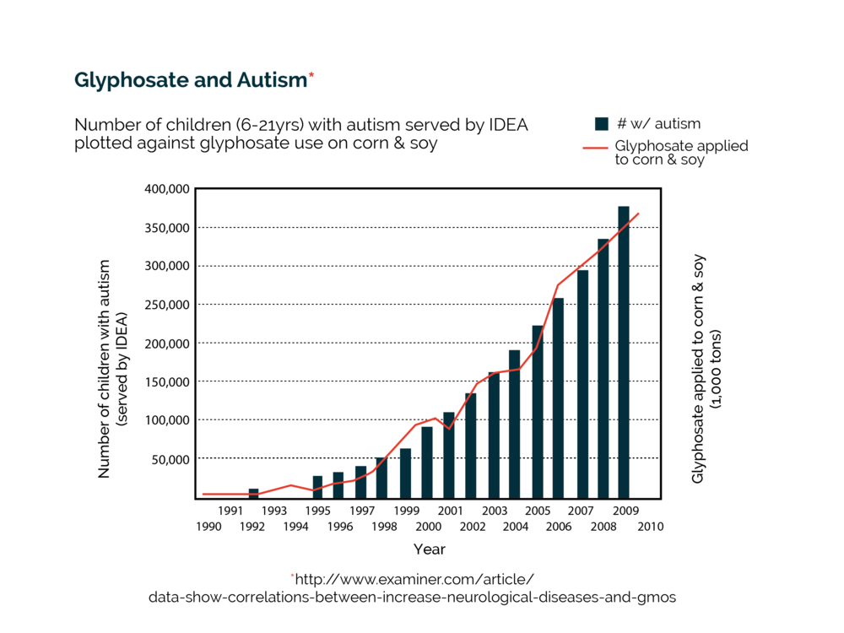
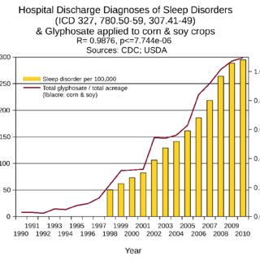
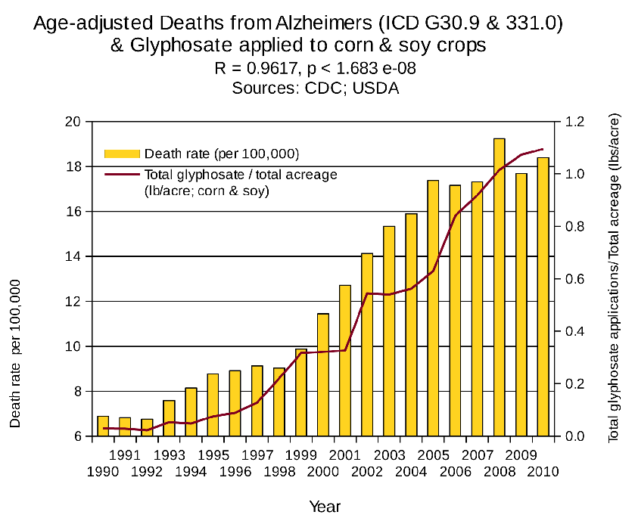
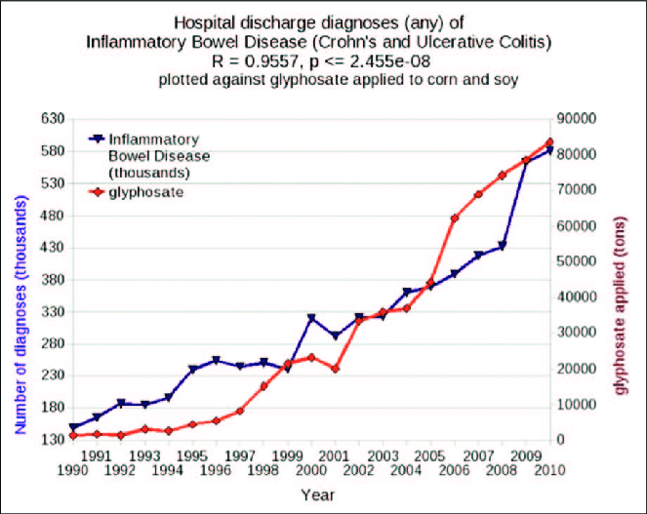
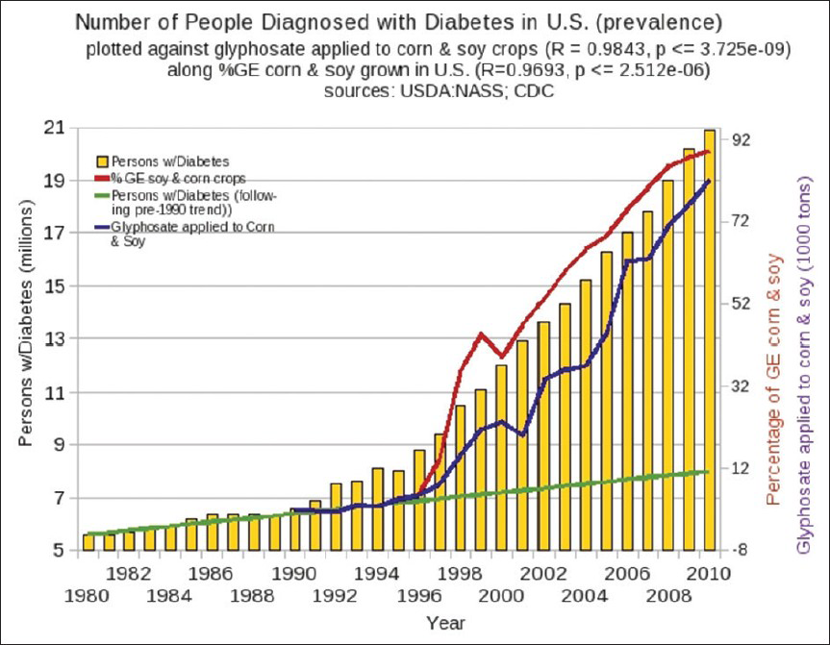
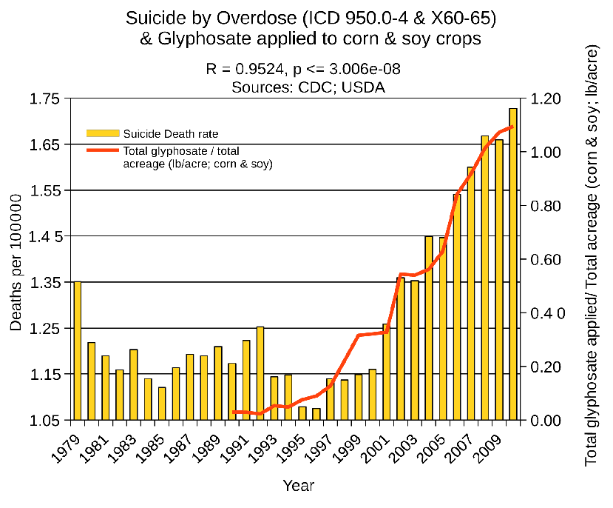
Something Changed From 1990 to 2010
Notes:
According to hospital discharge data, from 1990 to 2010 the incidence of autism, Alzheimer’s disease, celiac disease, sleep disorders, inflammatory bowel disease, and depression all roughly doubled or tripled.
Disease is a product of our genes and our environment. Our genes didn’t change so unless someone cast a magical spell that made people sick, we started doing something different.

Slide 34
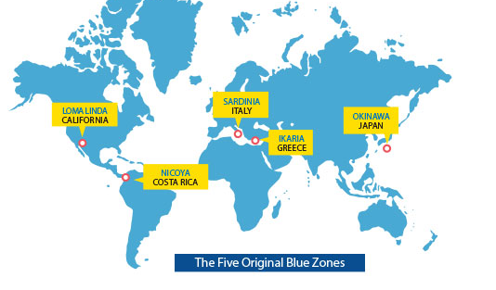
Populations With Higher Lifespans and Very Low Dementia
Notes:
There are small areas of the world known as "Blue Zones" where the incidence of Alzheimer's and autoimmune disease is almost non-existent. (Learn more about how Alzheimer's and autoimmune disease are strongly linked.) 5 areas were located using epidemiological data, statistics, birth certificates, and other research. These areas were dubbed Blue Zones, where people reach age 100 at 10 times greater rates than in the United States.

Slide 35
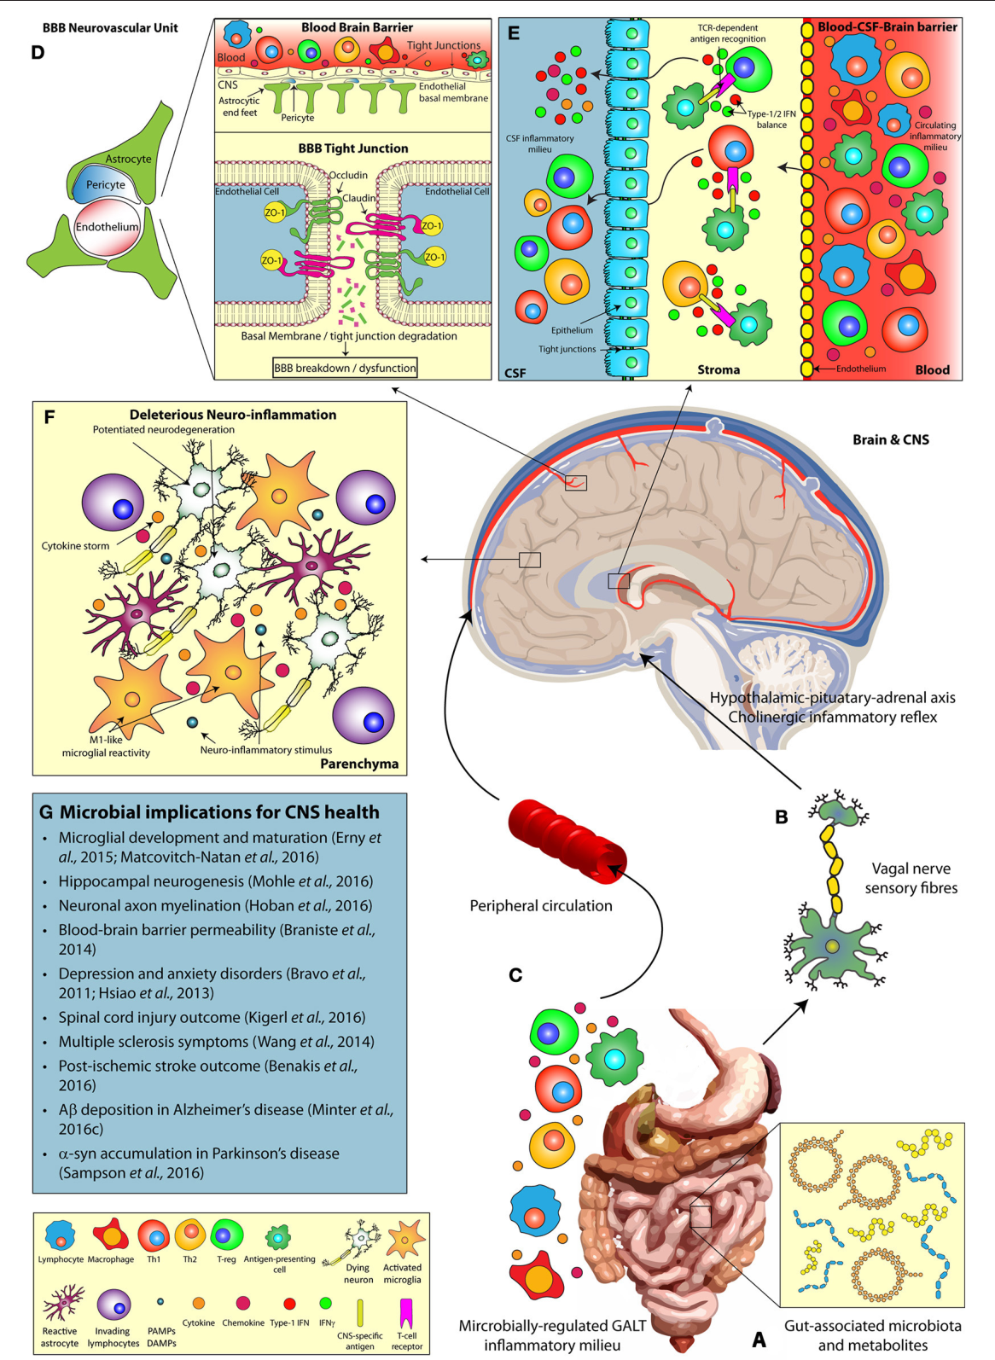
Mechanism Of Action
Diet Affects Gut Microbiome
Microbiome Affects the Immune System
Immune System Induces
Chronic Inflammation
Inflammatory Byproducts Produce Neurodegeneration

Slide 36
Just Figuring Out What We’re Doing Wrong Would Help A Half-billion People

Slide 37

PROBLEM
FDA and CDC Have Shockingly Little Data on the Relationships Between Dietary Factors and Disease

Slide 38
Open Epidemiology Project
We persuade the FDA and CDC to collect and publish longitudinal data on the relationships between dietary factors and prevalence of disease
Different Countries Have Different Diets and Regulations
Persuade World Health Organization to collect and publish disease incidence and diet data allowing to compare outcomes between countries

Slide 39
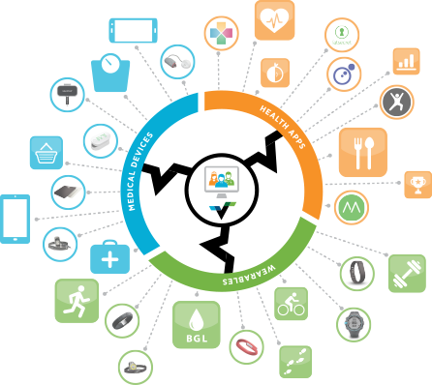

Slide 40
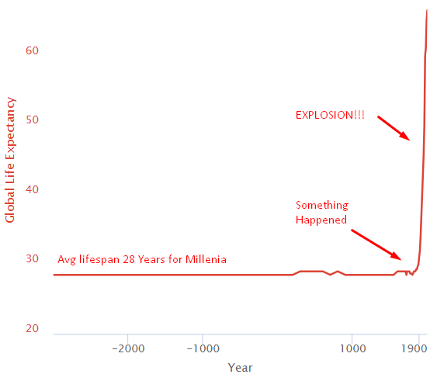
Health Explosion
Notes:
For thousands of years, everything sucked and the average human life expectancy was 28. Then something happened around 1800 and life-expectancy exploded.

Slide 41
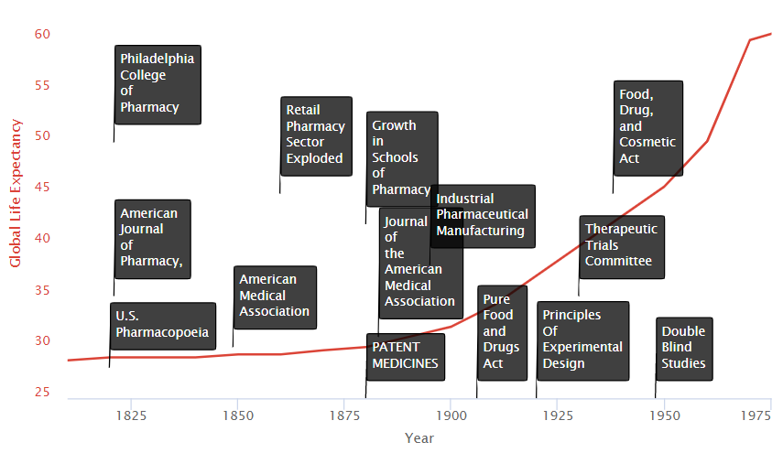
How It Happened
Notes:
We see on the timeline are two primary groups of factors:
Research Improvements
Incentive Improvements
Research Improvements
Schools of Medicine
An influx of new state-affiliated pharmacy schools in the 1880s and 1890s helped to raise the level of the practice significantly. Many like the University of Wisconsin combined laboratory science with an experiential requirement for graduation. The growth in schools of medicine trained physicians and researchers in the systematic collection of clinical data on the safety and efficacy of treatments. They also served as hubs where new medical discoveries could be shared.
Medical Journals
The advent of journals such as the Journal of the American Medical Association (JAMA) allowed new discoveries could also be widely disseminated.
AMA Drug Certifications
In 1905, the AMA formed its own Council on Pharmacy and Chemistry which levied a fee on manufacturers to evaluate their drugs for quality (ingredient testing) and safety. Drugs accepted by the Council could carry the AMA’s Seal of Acceptance. The AMA’s Chemical Laboratory tested commercial statements about the composition and purity of drugs in their labs. The Council on Pharmacy and Chemistry followed up with safety evaluations and rudimentary efficacy evaluations designed to eliminate exaggerated or misleading therapeutic claims. The Seal was awarded to drugs that provided symptomatic relief.
Cooperative Investigations
During the 1920s, ’30s, and ’40s medical researchers began to conduct “cooperative investigations”. These were designed to overcome errors attributed to individual observers working in relative isolation. It instead replaced them with standardized evaluations of therapeutic research in hundreds of patients.
Freedom to Try
Therapeutic experimentation did not begin to gain a true foothold in modern medicine until the U.S. legal system stopped equating experimentation with medical malpractice. In 1935, the state of Michigan authorized controlled clinical investigations as a part of medical practice without subjecting the researcher to strict liability (without fault) for any injury so long as the patient consented to the experiment. In particular, the court accepted that experimentation was necessary not just to treat the individual, but also to help medicine progress. “We recognize,” noted the Court, “the fact that if the general practice of medicine and surgery is to progress, there must be a certain amount of experimentation carried on.”
Incentive Improvements
Medical Patent Protections & Mass Production
In the late nineteenth and early twentieth century, interest in clinical objectivity grew, spurred on not only by astounding successes in laboratory science and clinical medicine abroad (e.g. discovery of microbes, pasteurization of milk, development of anthrax and rabies vaccines). International recognition of medical patents contributed to a boom in large-scale industrial pharmaceutical manufacturing led by Bayer and Pfizer. In 1880, patent medicines constituted 28% of marketed drugs. By 1900, however, they represented 72% of drug sales.
The industrial revolution gave way to technologies allowing for mass production and distribution on a global scale. This is vastly more efficient, and profitable than traditional means. These greater profits drove greater investment and thereby greater medical progress in the field.

Slide 42
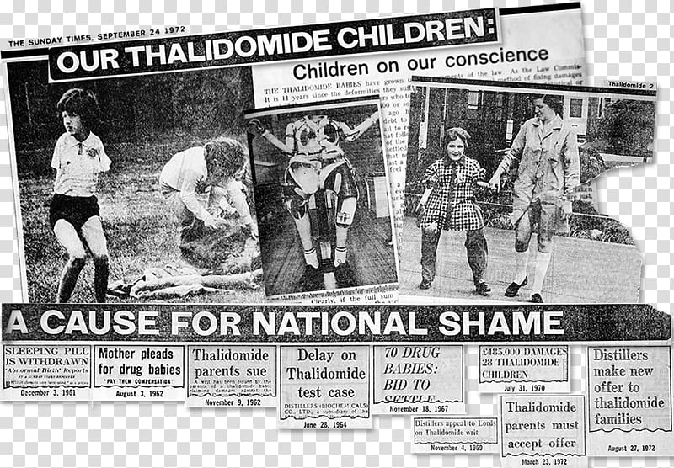
Notes:
In the late 1950s, the drug thalidomide became available in 46 countries (but not the US) to treat nausea associated with morning sickness during pregnancy. Unfortunately, the potential side effects were not fully understood. As a result, thousands of children were born with birth defects, most notably phocomelia (limb malformations).

Slide 43
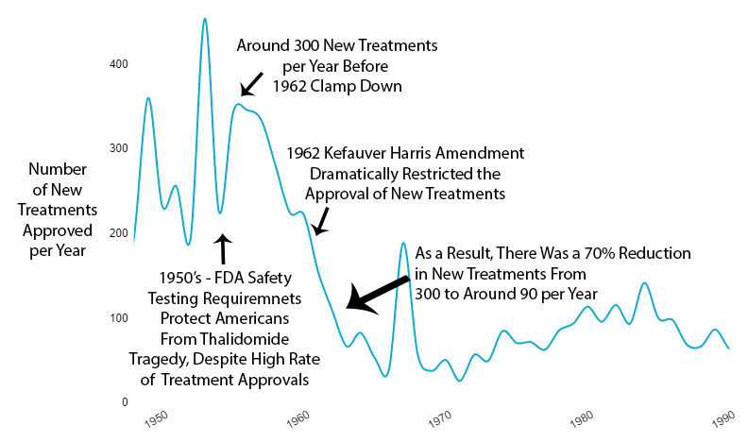
70% Reduction in New Treatments
Notes:
Fortunately, the existing 1938 FDA safety requirements completely protected Americans from the fate of Europe. However, amid the mass hysteria over the tragedy, the US government felt compelled to look like it was doing something in response.
As effective safety regulations were already in place, the government instead chose to restrict the production of new treatments primarily by requiring extensive additional efficacy testing via the 1962 Kefauver Harris Amendment.
The new regulatory clampdown on approvals immediately reduced the production of new treatments by 70%.

Slide 44
Decentralized Efficacy Trials Before 1962
When all other treatments had failed, the
144,000 Physicians in the American Medical Association
were allowed to offer suffering or dying
patients the option of trying proven-safe treatments
For which the effectiveness was not yet known.
Data on the effectiveness for many conditions was provided
For Studies in the Journal of the American Medical Association
AMA gave its seal to treatments found to be effective
Notes:
Efficacy Trials Before 1962
There are hundreds of conditions that a given drug may be effective at treating. However, it’s impossible to know which conditions a drug may improve until it is tried by real-world patients.
Prior to the 1962 regulations, it cost a drug manufacturer an average of $74 million dollars (2020 inflation-adjusted) to develop and test a new drug for safety before bringing it to market. Once the FDA had approved it as safe, efficacy testing was performed by the third-party American Medical Association.
The AMA would collect data from its 144,000 physicians members on the efficacy of different drugs for various conditions. Once it was determined which conditions a drug was or was not effective for, the results would be published in the Journal of the American Medical Association (JAMA). The AMA would only give its seal to drugs which it had determined were safe and effective for specific conditions.
The 1962 regulations made these large real-world efficacy trials illegal. Ironically, despite the fact that the new regulations were primarily focused on ensuring that drugs were effective through controlled FDA efficacy trials, they massively reduced the quantity and quality of the efficacy data that was collected for several reasons:
New Trials Were Much Smaller
Were Far More Expensive
Participants Were Less Representative of Actual Patients
They Were Run by Drug Companies with Conflicts of Interest Instead of the 3rd Party AMA

Slide 45
Conducted By 144,000 Physicians Through The Independent American Medical Association Voluntarily On Thousands Of Representative Patients
Efficacy Trials
BEFORE 1962 After
Conducted By Pharmaceutical Companies On
As Few As 20 People Selected By Company Using Exclusion Criteria
Notes:
Over the previous 50 years, rapid advancements in medical science had been producing a 4-year increase in human lifespan every year. This amazingly linear growth rate had followed millennia with a flat human lifespan of around 28 years. Following this new 70% reduction in the pace of medical progress, the growth in human lifespan was immediately cut in half to an increase of 2 years per year.

Slide 46
85% of Depression Patients Are Excluded from Studies Because They
Suffer from multiple mental health conditions (post-traumatic stress disorder, generalized anxiety disorder, bipolar disorder, etc.)
Engage in drug or alcohol abuse
Suffer from mild depression (Hamilton Rating Scale for Depression (HAM-D) score below the specified minimum)
Use other medications
Notes:
Exclusion Criteria
Subjects in FDA Trials Are Not Representative of the Actual People Receiving Treatment
External validity is the extent to which the results can be generalized to a population of interest. The population of interest is usually defined as the people the intervention is intended to help.
Phase III clinical trials are designed to exclude a vast majority of the population of interest. In other words, the subjects of the drug trials are not representative of the prescribed recipients, once said drugs are approved. One investigation found that only 14.5% of patients with major depressive disorder fulfilled eligibility requirements for enrollment in an antidepressant efficacy trial.
As a result, the results of these trials are not necessarily generalizable to patients matching any of these criteria:
Suffer from multiple mental health conditions (e.g. post-traumatic stress disorder, generalized anxiety disorder, bipolar disorder, etc.)
Engage in drug or alcohol abuse
Suffer from mild depression (Hamilton Rating Scale for Depression (HAM-D) score below the specified minimum)
Use other psychotropic medications
These facts call into question the external validity of standard efficacy trials.
The fact that co-morbidities are excluded also makes it impossible to discover potential new uses for a treatment.
New Trials Were Very Small
Due to exclusion criteria and added cost, patient sample sizes are very small. The number of subjects per trial on average is:
275 patients are sought per cardiovascular trial
20 patients per cancer trial
70 patients per depression trial
100 per diabetes trial

Slide 47
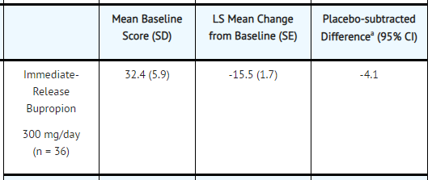
Wellbutrin Effectiveness from FDA Website
Millions Of People Are Prescribed This
Drug Based On 36 Subjects Unrepresentative
Of 85% Of Real-world Patients
Notes:
Exclusion Criteria
Subjects in FDA Trials Are Not Representative of the Actual People Receiving Treatment
External validity is the extent to which the results can be generalized to a population of interest. The population of interest is usually defined as the people the intervention is intended to help.
Phase III clinical trials are designed to exclude a vast majority of the population of interest. In other words, the subjects of the drug trials are not representative of the prescribed recipients, once said drugs are approved. One investigation found that only 14.5% of patients with major depressive disorder fulfilled eligibility requirements for enrollment in an antidepressant efficacy trial.
As a result, the results of these trials are not necessarily generalizable to patients matching any of these criteria:
Suffer from multiple mental health conditions (e.g. post-traumatic stress disorder, generalized anxiety disorder, bipolar disorder, etc.)
Engage in drug or alcohol abuse
Suffer from mild depression (Hamilton Rating Scale for Depression (HAM-D) score below the specified minimum)
Use other psychotropic medications
These facts call into question the external validity of standard efficacy trials.
The fact that co-morbidities are excluded also makes it impossible to discover potential new uses for a treatment.
New Trials Were Very Small
Due to exclusion criteria and added cost, patient sample sizes are very small. The number of subjects per trial on average is:
275 patients are sought per cardiovascular trial
20 patients per cancer trial
70 patients per depression trial
100 per diabetes trial

Slide 48
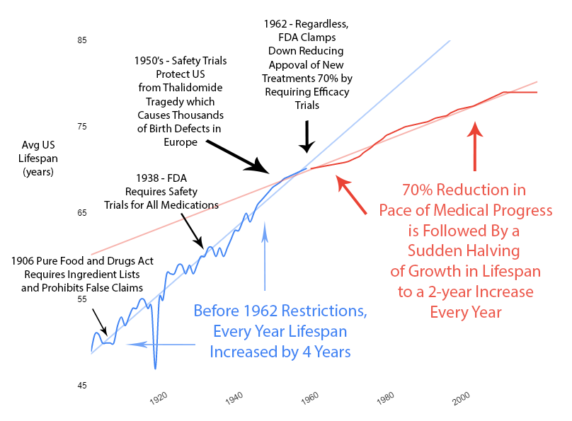
Fewer New Life-Saving Treatments Slowed Growth in Lifespan
Notes:
Over the previous 50 years, rapid advancements in medical science had been producing a 4-year increase in human lifespan every year. This amazingly linear growth rate had followed millennia with a flat human lifespan of around 28 years. Following this new 70% reduction in the pace of medical progress, the growth in human lifespan was immediately cut in half to an increase of 2 years per year.

Slide 49
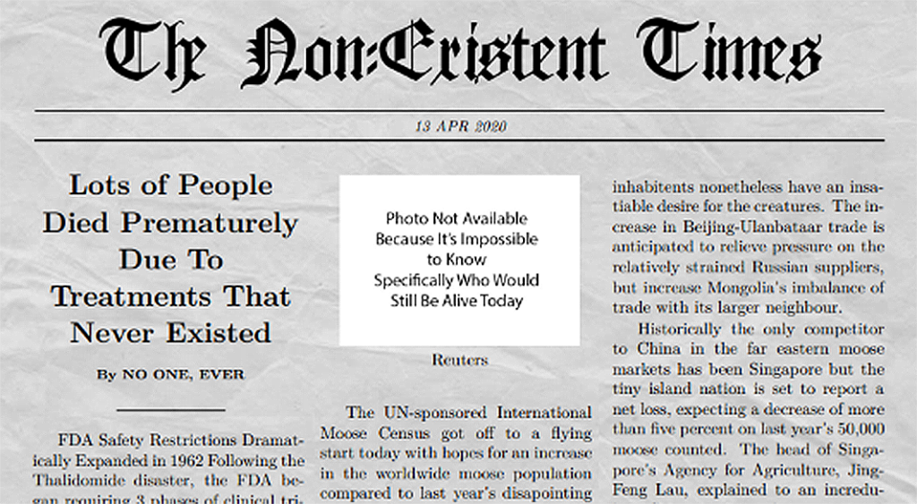
Notes:
Here’s a news story from the Non-Existent Times by No One Ever without a picture of all the people that die from lack of access to life-saving treatments that might have been.

Slide 50
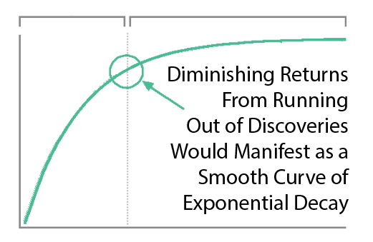
Diminishing Returns?
Notes:
You might say “It seems more likely — or as likely — to me that drug development provides diminishing returns to life expectancy.” However, diminishing returns produce a slope of exponential decay. It may be partially responsible, but it’s not going to produce a sudden change in the linear slope of a curve a linear as life expectancy was before and after the FDA.
Additionally, we’re only 3 lifetimes from George Washington. The modern scientific method has only been systematically applied to medicine for like .0001% of human history. However, the more clinical research studies I read, the more I realize we don’t know. We know basically nothing at this point compared to what will eventually be known about the human body. And the currently highly restrictive overly cautious method of clinical research prevents us from knowing more faster. We’re at the very beginning of thousands or millions of years of systematic discovery. So it’s unlikely that this decline in lifespan growth is the result of diminishing returns due to our running out of things to discover.

Slide 51
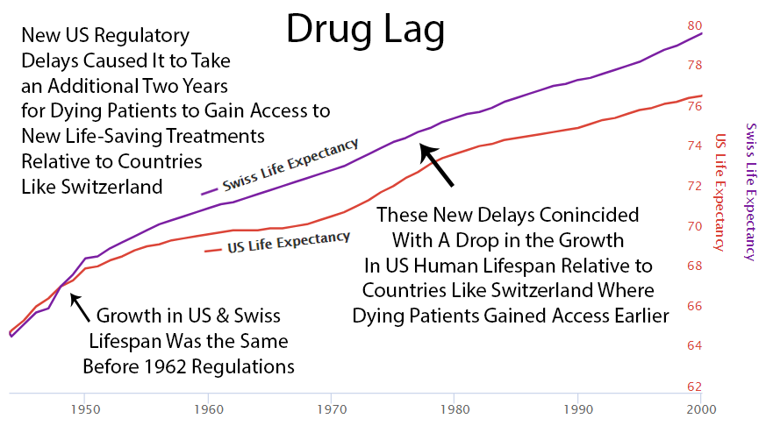

Slide 52
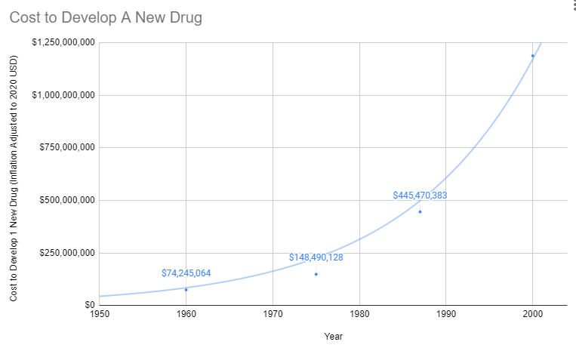
Notes:
Treatments for Rare Diseases Make No Financial Sense
The costs of FDA regulations do not vary with the number of potential users of the drug, so the decline in drug development has been especially important in the treatment of rare diseases. By definition, each rare disease afflicts only a small number of people, but there are thousands of rare diseases. In aggregate, rare diseases afflict millions of Americans: according to an AMA estimate (AMA 1995), as many as 10 percent of the population. Thus, millions of Americans have few or no therapies available to treat their diseases because of increased costs of drug development brought about by stringent FDA “safety and efficacy” requirements. In response to this problem, in 1983 the Orphan Drug Act was passed to provide tax relief and exclusive privileges to firms developing drugs for diseases affecting two hundred thousand or fewer Americans (AMA 1995). It would be better to reduce or eliminate FDA regulations for all drugs and patient populations.
Oligopolies Protect Existing Inferior Treatments
Prior to 1962, a brilliant scientist could come up with a new treatment, raise $74 million dollars for safety and efficacy testing, and bring it to market. With the current cost of bringing a new treatment to market over a billion dollars, there are only a handful of companies with enough money to risk a billion with a 90% chance of rejection by the FDA. So today the brilliant scientist goes to one of these companies and the company buys the patent for several million dollars. It’s likely the drug company already has an existing inferior drug on the market that they’ve already spent a billion dollars getting approved.
Then the drug company has 2 options:
Option 1: Risk $1 billion on clinical trials
Possibility A: Drug turns out to be one of the 90% the FDA rejects. GIVE BANKER A BILLION DOLLARS. DO NOT PASS GO.
Possibility B: Drug turns out to be one of the 10%, the FDA approves. Yay!!! Now it’s time to try to recover that billion dollars. However, there are very few drug companies with enough money to survive this game. So, this company almost certainly already has an existing crappier drug on the market to treat the same condition. Hence, any profit they make from this drug will likely be subtracted from revenue from existing inferior drugs they’ve already spent a billion dollars on.
Option 2: Put the patent on the shelf
Do not take a 90% chance of wasting a billion dollars on failed trials. Do not risk making your already approved cash-cow drugs obsolete.
What’s the benefit of bringing better treatment to market if you’re just going to lose a billion dollars? Either way, the profit incentive is entirely in favor of just buying better treatments and shelving them.
With the incentives completely stacked against the discovery of new treatments, it’s amazing there’s any medical progress whatsoever. In fact, a complete stoppage in medical progress is exactly what we’ve seen if it’s measured by lifespan.

Slide 53
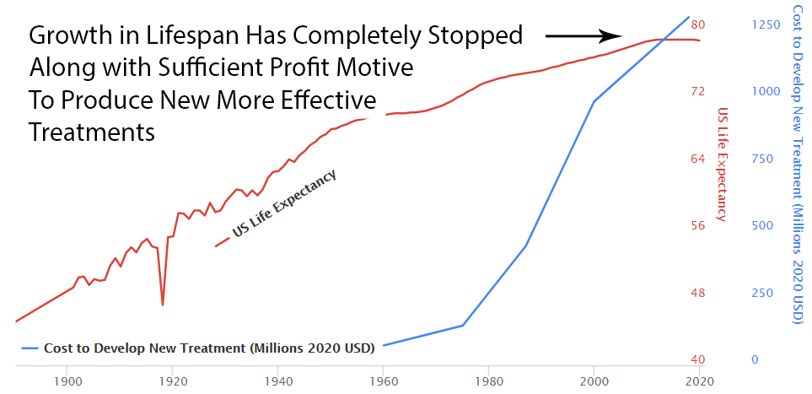

Slide 54
Solutions
- Large Scale Decentralized Clinical Trials
- Improved FDA Mandate

Slide 55
Current FDA Mandate:
Ensure all drugs are safe and effective.
New Mandate
Maximize human health and longevity.

Slide 56
Decentralized
Large Scale Clinical Trials

Slide 57















SYMPTOM SEVERITY IS INFLUENCED BY MANY FACTORS
Diet
Social
Symptom Severity
Sleep
Exercise
Environment
Treatments
Notes:
...is that they can be exacerbated or improved by hundreds of factors in daily life like
How much sleep did I get?
What medications did I take?
How much sugar did I consume?
How much gluten did I consume?
gluten intake,
Sugar,
diet,
sleep,
exercise,
social interaction,
and even the weather!
Unfortunately, the human mind evolved to survive in a world without data millions of years ago is only capable of holding 7 numbers in working memory at a time.
Exclude recommended daily allowance
Brains don’t have the bandwidth or statistical processing power required to analyze the massive amount of longitudinal data, time delays, and durations of action that has to be taken into account if we are to determine the likely influence of each of these factors on the individual’s symptoms.
So I built QuantiModo to aggregate and analyze the oceans new active and passively generated human data to determine which of these hundreds of factors have the strongest relationships the symptom or outcome of interest.

Slide 58
SYMPTOM SEVERITY INFLUENCERS
Diet
Social
Symptom Severity
Sleep
Exercise
Environment
Treatments
Notes:
...is that they can be exacerbated or improved by hundreds of factors in daily life.
Unfortunately, the human mind is only capable of holding 7 numbers in working memory at a time.
Brains don’t have the bandwidth or statistical processing power required to analyze the
massive amount of data.
REFERENCE
Brains don’t have the bandwidth or statistical processing power required to analyze the
massive amount of longitudinal data, time delays, and durations of action that has to be taken into account if we are to determine the likely influence of each of these factors on the individual’s symptoms.
So we built QuantiModo to aggregate and analyze this data to determine which of these hundreds of factors have the strongest relationships the symptom or outcome of interest.

Slide 59





CASE STUDY
Anxiety
Psoriasis
Back Pain
Notes:
To better illustrate what an empirical approach to chronic illness looks like, I’d like to briefly tell you about my experience.
I’ve ben using data to solve problems for about 15 years. Initially, I got my degrees in electrical engineering and physics. Then I spent 10 years using various analytical tools and data analysis to solve thousands of industrial problems as the Director of Chemical Testing at St. Louis Testing Laboratories.
At the lab, we would do a lot of root cause failure analysis for different industries. This generally consisted of gathering data, analyzing it, and using as a basis for research to identify root causes and effective solutions.
During my time there, I developed a number of health conditions like back and joint pain, psoriasis and anxiety. My doctor sent me to several specialists who prescribed an array of medications. These were moderately successful at masking the symptoms but they were very expensive and carried a number of side effects with them. So I decided to apply the same techniques we used in the root cause failure analyses at my lab to figure out what the hell was wrong with me. REFERENCE
While I was there, I developed a number of health symptoms including psoriasis, anxiety, and back and joint pain. My doctor sent me to several specialists. The specialists prescribed an array of medications. These were moderately successful at masking the symptoms but they were very expensive and carried a number of side effects with them. In fact, my Humira prescription cost $25,000 a year.

Slide 60


Self-Quantification
Notes:
So I started tracking my symptom severity, diet, medications, physical activity, sleep and other influencers with a number of different apps and devices. I then exported the data to a bunch of spreadsheets and analyzed, and made several very important discoveries.

Slide 61
Notes:
Name all 4 quickly
And finally, this enables the user to select any symptom or outcome of interest and then see which factors are most predictive of that outcome. Here we see the top factors most predictive of reduced inflammatory pain. The strongest predictor is Omega 3 Fatty acids that this says that my inflammatory pain is typically 27% lower after I take 400mg of inflammatory pain.

Slide 62


Notes:
Name all 4 quickly
And finally, this enables the user to select any symptom or outcome of interest and then see which factors are most predictive of that outcome. Here we see the top factors most predictive of reduced inflammatory pain. The strongest predictor is Omega 3 Fatty acids that this says that my inflammatory pain is typically 27% lower after I take 400mg of inflammatory pain.

Slide 63
What We Have
10,000 Users in Over 50 Countries
12 Million Data Points Obtained
Notes:
We already have 3000 users and 5 million data points with no marketing efforts and have received very positive reviews on the app stores.
90,000 NATURAL LANGUAGE STUDIES ON THE EFFECTS OF VARIOUS FACTORS ON SYMPTOMS OF CHRONIC ILLNESS

Slide 64
Groceries
Medications
Supplements
All of Us Open Humans Project
Open Humans
All of Us Data and Research Center
Physicians
Developers
Insurance
Patients
Researchers
Notes:
A half billion are suffering [pause here] from autoimmune diseases like Crone's disease, psoriasis, and Fibromyalgia.
Another half a billion people are suffering from depression and other mental illnesses.
Indeed 12 people will have committed suicide by the end of this presentation. Hopefully, not as a result of this presentation, but I believe due to massive failures in our current systems of clinical research and diagnosis. Currently, it costs as much as $48,000 per subject in a Phase III clinical trial. This has resulted in very little data on the effects of any factors that aren’t patentable. Furthermore, something that all of these diseases have in common…

Slide 65






COORDINATION
97,000 Health Apps
7 Million Researchers
1.3 Billion Patients
35 Health Insurers
8 Million Healthcare
Providers
165 Pharmaceutical
Companies
Notes:
Should be at 6:00 here
Limit to
Leave numbers out of dictation
Introduce Renato – 1:45
Who Will Pay, 6 segments
Developers
There are 97,000 health apps which can save months of development time and tens of thousands of dollars by using our platform instead of reinventing the wheel.
Researchers
It currently costs $48k per subject in a phase 3 clinical trial. Instead of spending months gathering data, we create a shareable url that researchers can share with participants to authorize access to pre-existing data in quantities never seen before.
Patients
Using our client apps and browser extensions, patients can easily track their symptoms, import data from other sources, and discover hidden dietary, behavioral, and environmental factors that could be exacerbating or improving their symptoms.
Health Insurers
Furthermore, this new digital health solution would help to drive down cost for insurance providers. Health plan providers need a more personalized approach to help their members and have found a way to do so with provider-and patient-reported digital health data. By incorporating this data into a centralized repository, payers can analyze and use this information to create and improve their various member services. For example, in addition to supporting patient-specific care-management models, integrated data could enable the creation of wellness programs, preventive or disease-management care initiatives or even health-coaching programs. This personalized data can go beyond incentivizing and motivating healthy lifestyles; it can also help payers increase member engagement, a critical objective for many health plan providers.
Pharmaceutical Companies
106,000 people die annually in the U.S. from properly prescribed drugs. The number of people having in-hospital, adverse reactions to prescribed drugs to be 2.2 million per year. The total number of deaths caused by conventional medicine is 783,936 per year. Pharmaceutical companies spend over $2 billion a year on over 314,000 events attended by doctors.
Initial sponsor applications will be focused on tracking adverse reactions to the medications known to produce the most adverse reactions. MEDTLC, QuantiModo’s treatment and symptom tracking application would reduce the number of deaths and costs of intervention by alerting patients and their practitioners to conditions before they become irreversible. Additionally, the opportunity to meet and promote these applications to physicians would also serve as a novel new way for pharmaceutical manufacturers to connect with physicians.
Healthcare Providers
A dashboard visualizing all factors in a patient’s health can then help doctors formulate an informed care plan.

Slide 66
Reduce Development Costs and Increase Data Security By Requiring Publicly Funded Projects Be Open-Source for Anyone to Use and Contribute To
Reduce Exploding Healthcare Costs by Accelerating the Discovery of Unpatentable Means of Preventing and Curing Disease
International Data Sharing And Development Efforts Will Reduce Duplication of Effort and Benefit from Regulatory Epidemiological Natural Experiments
Policies
Companies Can Share Data and Reduce Healthcare Expenditure by Facilitating Preventative Discoveries
Patients can see which controllable hidden factors most likely affect disease severity or development
Coordinate with Government
Supplement Data
Engage Individuals
Work with Business
Grocery Data
Medication Data
1.3 Billion Patients
Any Developer Can Contribute to Data Analysis or Integration and Reuse Code in Their Own Projects
Open-Source Platform
Insurance Data
Collaborate with Non-Profits
Digital Health Companies
Digital Health Companies Can Reuse Software and Data In Their Own Products
Non-Profits Can Use Apps and Studies to Promote Research and Member Engagement Which is More Productive Than Charity Walks
Notes:
Should be at 6:00 here
Limit to
Leave numbers out of dictation
Introduce Renato – 1:45
Who Will Pay, 6 segments
Developers
There are 97,000 health apps which can save months of development time and tens of thousands of dollars by using our platform instead of reinventing the wheel.
Researchers
It currently costs $48k per subject in a phase 3 clinical trial. Instead of spending months gathering data, we create a shareable url that researchers can share with participants to authorize access to pre-existing data in quantities never seen before.
Patients
Using our client apps and browser extensions, patients can easily track their symptoms, import data from other sources, and discover hidden dietary, behavioral, and environmental factors that could be exacerbating or improving their symptoms.
Health Insurers
Furthermore, this new digital health solution would help to drive down cost for insurance providers. Health plan providers need a more personalized approach to help their members and have found a way to do so with provider-and patient-reported digital health data. By incorporating this data into a centralized repository, payers can analyze and use this information to create and improve their various member services. For example, in addition to supporting patient-specific care-management models, integrated data could enable the creation of wellness programs, preventive or disease-management care initiatives or even health-coaching programs. This personalized data can go beyond incentivizing and motivating healthy lifestyles; it can also help payers increase member engagement, a critical objective for many health plan providers.
Pharmaceutical Companies
106,000 people die annually in the U.S. from properly prescribed drugs. The number of people having in-hospital, adverse reactions to prescribed drugs to be 2.2 million per year. The total number of deaths caused by conventional medicine is 783,936 per year. Pharmaceutical companies spend over $2 billion a year on over 314,000 events attended by doctors.
Initial sponsor applications will be focused on tracking adverse reactions to the medications known to produce the most adverse reactions. MEDTLC, QuantiModo’s treatment and symptom tracking application would reduce the number of deaths and costs of intervention by alerting patients and their practitioners to conditions before they become irreversible. Additionally, the opportunity to meet and promote these applications to physicians would also serve as a novel new way for pharmaceutical manufacturers to connect with physicians.
Healthcare Providers
A dashboard visualizing all factors in a patient’s health can then help doctors formulate an informed care plan.

Slide 67
Benefits
Potential Treatment/Prevention of Alzheimer’s or Depression for self or family
Saving 365,297 lives/year
Preventing 1,056,000,000,000 hours of suffering/year
Notes:
Cost Benefit Analysis
Here is a brief summary of the cost and benefits to help you decide if you want to further explore the foundation opportunity. Please correct me if there are any mathematical errors.
Costs
Monetary
Initial investment of $2.6M = Rob's Initial Investment of Otherwise Disposable Cash = $5M Stock - $2.4M Avoided Taxes
Years Until Foundation $350K Payouts Exceed Initial $2.6M Investment = $2.6M/$350k = 7.4 years
After accounting for income taxes $2.6M/$280k = 9.2 years
Taxes
0.2% excise tax on total endowment or 2% on annual gains
17% effective income tax rate average on everyone on payouts since bottom bracket up to $50k is only 12%
Effort Required
Initial consultation with lawyer and accountant
Review and sign Articles and Bylaws
Board meetings 1-4 times per year.
Everyone must remember their job title and job description in case anyone asks about it. I can do all everyone's duties listed on their job descriptions. Then I can tell everyone what they've done to help maintain the illusion that everyone is required to support the mission of the foundation.
Benefits
Taxes
Initial Taxes Avoided = $2.4M
Foundation investment capital gains avoided
Personal income
$350k in salary and avoided gifts * 30 years = $10.5M
$15.1M in relative long term gains if each of the 20 additional $280k annual after tax payout and avoided gifts can be invested with 10% rate of return

Slide 68

6 million Jews died in the holocaust.
Every decade, 8 million people commit suicide.
So, there is the equivalent of an endless succession of holocausts occurring every decade.
In 2020, the US spent $1.6 billion on research to solve this problem through the National Institute of Mental Health.
In 2020, the US created $4000 billion and transferred it to the top 1% through the Federal Reserve’s Open Market Operations program.

Slide 69

This is a solvable chemistry problem
We know the biochemical mechanism
Treatments are in development
Progress is limited by resource constraints

Slide 70

Alzheimer’s is Likely an avoidable genetic process triggered by environmental and behavioral factors
Your foundation can help to collect the data on behavioral and environmental triggers and develop a means of prevention or slowing progression of the disease

Slide 71

Calculating Benefits of Clinical Research
Notes:
Consider a failure analysis combo job at the lab.
A failure analysis consists of
- testing a sample
- gathering data
- analyzing the data to try to identify the root cause
- often doing research based on the data to find a possible remedy
- writing a report
Let’s say:
you can only afford to hire one lab technician to do everything
it will take this lab tech 100 hours of labor to complete this job

Slide 72

Calculating Benefits of Clinical Research
Notes:
Consider a failure analysis combo job at the lab.
A failure analysis consists of
- testing a sample
- gathering data
- analyzing the data to try to identify the root cause
- often doing research based on the data to find a possible remedy
- writing a report
Let’s say:
you can only afford to hire one lab technician to do everything
it will take this lab tech 100 hours of labor to complete this job

Slide 73
$100K per Year Could hire 2 Researchers Shifting the time of discovery forward 2 research years

Slide 74


Slide 75

Despite uncertainty, it’s logical to try to avoid this hell on earth anyway
 | We Succeed | We Fail
We Try | Prevent Billions of Hours of Suffering and Save Millions of Lives | Billions of Hours of Suffering and Millions of Deaths
We Don’t Try | Billions of Hours of Suffering and Millions of Deaths | Billions of Hours of Suffering and Millions of Deaths
We Try
Notes:
It’s impossible to know until you get it. However, it’s kind of like Pascal’s Wager that states your best option is to assume God exists. The negative consequence of being wrong in your belief are trivial whereas the negative consequences of disbelief in God are the worst imaginable.

Slide 76
By accelerating the discovery of effective treatments and means of prevention you WILL be saving 246 Million people from 4,018,264,840 HOURS of Suffering Each Year

Slide 77

Total Addressable Market
613 Million People Track a Health Indicator
x $3 /user/year
= $1.8 Billion TAM
Notes:
We have 6 different segments with 6 different pricing models…
The digital health space has been growing with a massive 50% compound annual growth rate. The healthcare analytics market is a $30 billion dollar industry and includes remote patient monitoring, telehealth, and behavior modification technologies.
Given that Validic and the Human API are already charging about $4 or $5 per year per user. So we believe that $3 per year per user is a competitive price point for us.
613 million people are tracking a health indicator.
$3 per individual per year produces a $1.8 billion dollar total addressable market for QuantiModo.

Slide 78


Financial and Traffic Projections
Diet tracking is arduous, and its value is minimal in isolation from other data sources. As such, we’ve set MyFitnessPal’s historical traffic trajectory as our pessimistic estimate.
We’ve used WebMD’s historical traffic for our optimistic projection.
Profit = Unique Monthly Visitors x 12 months x 4% CTR x 68% Revenue Share x $2.16 Average Health CPC - Cost of Revenues - R&D - Sales and Marketing - General & Administrative Costs
Year 1 Personnel Expenses
Back End Web Developer $75,000
Front End Web/UI/UX Developer $77,000
Project Manager/Marketing/Business Dev $72,000
Systems Administrator / DevOps $73,000
Data Scientist $90,000
Total $387,000
Year 1 Other Expenses
Rent / Utilities $12,000
Payroll / Benefits $48,608
Legal and Accounting $16,912
Software Licensing $5,000
Administrative Total $6,000
Web Hosting Total $12,000
Total $103,100
Post-Revenue Costs as % of Revenue
Traffic Acquisition Cost 24%
Other Cost of Revenues 14%
Research & Development 13%
Sales & Marketing 12%
General & Administrative 8%
Total Variable Costs 71%

